Slide 1
comp1911
client side web scripting
using javascript
day 1

Slide 2
workshop overview
hour 1: resources, history, standards, browsers, DOM, <script>, <noscript>
hour 2: dialogs, custom javascript functions and files
hour 3: image rollovers, text rollovers
hour 4: object-, browser-, and plugin-detection
hour 5: debugging javascript; timers; animation
hour 6: form manipulation and validation
hour 7: regular expressions (possibly)
hour 8: window manipulation
hour 9: cookies
hour 10: dynamic effects: marquees, scrollers
hour 11: dynamic effects: menus, tabs
hour 12: test

Slide 3
resources
signalflare.ca/comp1911 course website
www.mozilla.org/js official manuals
javascript.internet.com/toc.html code archive
any website with JavaScript view source
http://www.lib.bcit.ca BCIT library
comp.lang.javascript listserv/newsgroups
ftp://share.bcit.ca BCIT’s server

Slide 4
history
Javascript was invented by Netscape in 1995
Javascript was unique: the only language to be interpreted by the browser itself
Has nothing to do with Java
Supported by virtually all browsers now
Some users/software disable Javascript
Competitors: Jscript (Javascript clone), VBScript (yuck)
Javascript is by far the most popular client-side scripting language on the web
There is also server-side Javascript, which is different than client-side Javascript and which is not covered in this workshop.

Slide 5
standards
The European Computer Manufacturers Association (ECMA) have define standard for client-side scripting languages: ECMAScript
Javascript complies with the ECMAScript standards
Makes life relatively easy for browsers which generally follow the standards
Browsers typically add additional non-standard features too, in order to attract more users to their browser
www.ecma-international.org/publications/
standards/ECMA-262.htm

Slide 6
browsers
Javascript is executed by the browser
Therefore the browser needs all of the Javascript code sent to it
Therefore users can also access this code (e.g. by selecting View → Source in the browser window)
Therefore Javascript is generally considered “open source”

Slide 7
no no no
Javascript is safe
ECMA standards specify things that Javascript is not permitted to do:
  read the hard drive of client computers
  execute other programs
  establish any connection to other computers, except to download new HTML pages or send mail.

Slide 8
no no no
JavaScript wants to protect the privacy of the user by disallowing some actions and asking permission for others:
You cannot read out the history of the browser
You can go back or forward in the browsing history, but you cannot find out which page that is
You cannot do anything in pages that come from another server. So if your frameset contains two pages from two servers, they cannot communicate with each other.
You cannot set the value of a file upload field (<input type="file">). document.forms[0].upload_field.value = '/my/password/file'; document.forms[0].submit();
If you try to close a browser window that has not been opened by JavaScript, the user is asked to confirm this action
If you try to submit a form to a mail address by JavaScript, the user is asked to confirm
You should not be able to open a new window smaller than 100x100 pixels and/or to position it outside the screen area of the computer

Slide 9
yes
Thus JavaScript is a scripting language for influencing HTML elements, like forms, images, layers, paragraphs and such, and for influencing a few non–HTML objects like the browser window.

Slide 10
versions and support
Javascript 1.0 was the first version
Then 1.1, 1.2, 1.3
There is no Javascript 1.4
Javascript 1.5 is the newest version
Javascript 2.0 is under development

Slide 11
versions and support
The following browsers have Javascript support:
JavaScript 1.5 is in browser versions 6 and higher.
JavaScript 1.4 is not used in browsers, only on Netscape servers
JavaScript 1.3 is in browser versions 5 and late version 4’s (IE bad!)
JavaScript 1.2 is in early version 4’s
JavaScript 1.1 is in version 3’s
JavaScript 1.0 is in Netscape 2
Earlier versions of Internet Explorer and Netscape do not have support for JavaScript.

Slide 12
dom
The Document Object Model (DOM) describes how Javascript can interact with the browser/Web page
Each browser has its own DOM
The DOM is in the process of being standardized by the World Wide Web Consortium (W3C):
http://www.w3.org/DOM

Slide 13
dom
Because different browsers have different DOMs, Javascript must interact differently with each browser
Not easy to write JS that works fine on “every” browser (there are thousands of browsers)
Each browser version and platform (e.g., IE 5 on a Mac vs. IE 5 on Windows) works differently.

Slide 14
dom
The DOM is an application programming interface (API) which JavaScript uses to access the various elements in HTML and XML documents.
As far as we are concerned in comp1911, the DOM connects JavaScript to our Web pages.
We use the DOM to add, delete, and change elements in our pages.

Slide 15
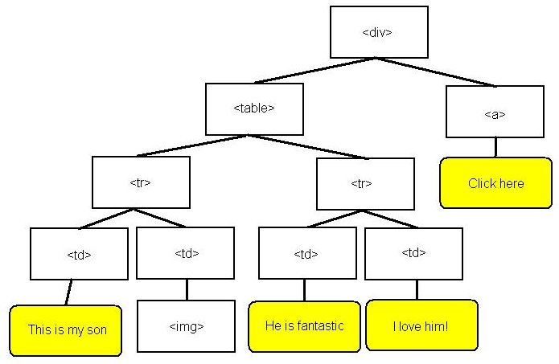
dom tree
<div>
<table>
<tr>
<td id = “son”>This is my son</td>
<td id = “pic”><img src = “./jaden.jpg”></td>
</tr>
<tr>
<td id = “he”>He is fantastic</td>
<td id = “love”>I love him!</td>
</tr>
</table>
<a href = http://signalflare.ca> Click here </a>
</div>
In fact, each of these should have a NAME attribute, and even an ID attribute

Slide 16
dom level 2
COMP1911 will focus on the DOM level 2 standard since all major browsers support it and the trend should continue.
One difficulty is that DOM level 2 scripts will not work in older browsers.

Slide 17
JavaScript and the W3C DOM
DOM Element Properties
childnodes
firstChild
lastChild
nextSibling
nodeValue
parentNode
previousSibling
<table id=“t”>
<tr>
<td>a</td>
<td>b</td>
<td>c</td>
</tr>
<tr>
<td>x</td>
<td>y</td>
<td>z</td>
</tr>
</table>

Slide 18
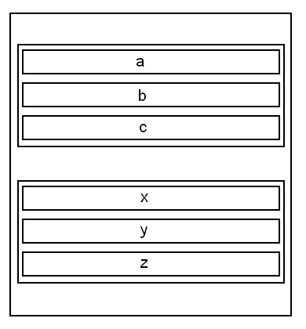
JavaScript and the W3C DOM
DOM Element Properties
childnodes
firstChild
lastChild
nextSibling
nodeValue
parentNode
previousSibling

Slide 19
JavaScript and the W3C DOM
DOM Element Properties
document.createElement(tagName)
document.createTextNode(text)
<element>.appendChild(childNode)
<element>.getAttribute(name)
<element>.setAttribute(name, value)
<element>.insertBefore(newNode, targetNode)
<element>.removeAttribute(name)
<element>.removeChild(childNode)
<element>.replaceChild(newNode, oldNode)
<element>.hasChildnodes()

Slide 20
JavaScript and the W3C DOM
<script language="javascript" type="text/javascript">
<!--
function addRowToEndOfTable(tableId) {
var newRow = document.createElement("tr");
var newTd = document.createElement("td");
var newText = document.createTextNode("hi");
newTd.appendChild(newText);
var currentLastRow = document.getElementById(tableId).lastChild;
newRow.appendChild(newTd);
currentLastRow.appendChild(newRow);
}
// -->
</script>

Slide 21
document.getElementById
This method gives us direct access to document elements, by specifying their ID attribute in the brackets. However, older browsers do not support the getElementById( ) method.
  <html>
  <head><title>Sports</title></head>
  <body>
  <div id = “sport_div”>
  <p id = “sports_p”>I love sports</p>
  <a href = http://www.nhl.com id = “hockey”>Hockey news!</a>
  <a href = http://www.defendo.com id = “defendo”>Defendo news!</a>
  </div>
  <div id = “food_div”>
  <p id = “food_p”>I love pizza, too!</p>
  </div>
  </body>
  </html>
The defendo anchor could be accessed using node relationship syntax, like this:
“document.firstChild.lastChild.firstChild.lastChild”, but there is a simpler way:
document.getElementById(“defendo”)

Slide 22
document.getElementById
This concise syntax is much better than the long node relationship syntax. In order to use the getElementById( ) method, follow these rules:
Use a browser which supports the method (IE 5+, NN 6+)
Give your HTML elements an id attribute
Make sure all id attributes have unique values (no duplicates)
Use this method only after the page has been fully loaded.

Slide 23
lesson 01
The DOM is quite complex, and there are in fact easier ways to manipulate an HTML document.
To learn more about using the DOM, read the course notes (lesson 01).
The rest of this workshop will focus on the “easier ways”.

Slide 24
script tags
The <script></script> tags tell the browser “the code that is between these tags is not HTML”. When writing JavaScript, use the LANGUAGE or TYPE attribute like this:
Example 1: commonly used but has been deprecated
<script language = “javascript”>
Everything in here must be JavaScript, not HTML.
</script>
Example 2: the newer technique
<script type="text/javascript">
Everything in here must be JavaScript, not HTML.
</script>
Example 3: the “best” technique
<script type = “text/javascript” language = “javascript”>
NOTE: There can be multiple <script></script> sections in your files, in the head or body sections.

Slide 25
script tags
In the head section of documents, you can use the CONTENT attribute of the HTTP-EQUIV metatag to specify the default scripting language; this makes it possible to leave out the LANGUAGE and TYPE attributes of the script tag:
<head>
<META HTTP-EQUIV = "Content-Script-Type" CONTENT = "text/javascript">
<title>meta tags</title>
</head>
<body>
<script>
This is assumed to be JavaScript!
</script>
</body>

Slide 26
script tags
If you do not specify a default language with the meta tag, and you do not specify the language/type attributes in your <script> tags, most Web browsers will assume that JavaScript is being used.
This is not a good idea!

Slide 27
comments and javascriptlessness
Comments are the key to hiding JavaScript from browsers which do not have JavaScript support.
Comments are intended to be read by other people, not by the browser.
A comment is “code that is totally ignored by the browser”.

Slide 28
hiding javascript
Old browsers do not understand javascript.
Some browsers have disabled javascript.
These old and disabled browsers will cause problems when they load a page which has javascript in it.
We want to hide the javascript from such browsers, to avoid problems/errors.

Slide 29
comments
To ensure that JavaScript-disabled browsers ignore JavaScript, use a combination of HTML comments and JavaScript comments.
<!-- this is an HTML comment -->
// this is a javascript comment
/* this is also a javascript comment */

Slide 30
heads up
Most javascript is written in the <head> section of the document.

Slide 31
old / disabled browsers
<script type = “text/javascript”>
<!--
ALL JAVASCRIPT GOES HERE
// -->
</script>
Lines 2, 3, and 4 are enclosed by HTML comments. Old / disabled browsers ignore the “script” tag (don’t recognize it), and by default want to print out everything inside the <script> tags directly to the screen. But they can’t SEE anything in the <script> tags! It’s commented out by HTML!

Slide 32
new / enabled browsers
<script type = “text/javascript”>
<!--
ALL JAVASCRIPT GOES HERE
// -->
</script>
New, enabled browsers DO recognize the <script> tag, and also know they should ignore the <!-- tag.
The --> tag has been commented out using javascript tags.

Slide 33
javascript, comments, etc…
In order to properly test your JavaScript scripts, you should install different browsers and different versions of each browser. This will be one of the labs due for this lesson.
Keep comments concise; unnecessary text slows down the transfer and execution of your Web pages.
Most browsers permit you to “shut off” javascript.

Slide 34
<noscript>
Any browser that supports the <script> tag will also support the <noscript> tag. These browsers will ignore the contents of the noscript code section.
Any browser that does not support the <script> tag will also not support the <noscript> tag. In the previous section of this lesson, we learned how to use comments to prevent such browsers from displaying the script section contents on the screen. If we use this technique, then old browsers will ignore the script code section. This is exactly what we want.

Slide 35
<noscript>
Old browsers will not understand the <noscript> section, so they will simply display the contents onto the screen. This can be good. For example, it is common to use the <noscript> section like this:
<noscript>
Old browsers will not understand this tag and will simply display these contents to the screen.
Example content includes the following:
Please upgrade your browser.
This page is optimized for browsers version 5 and higher.
<a href = "http://www.microsoft.com/windows/ie/default.asp">
Click here to get a new browser </a>
<a href = "./noscripting.html">
Click here to view the text version of this page </a>
</noscript>
<script type = "text/javascript"> <!--
document.write("Only new browsers will enter this section.<br>");
document.write("Old browsers without scripting support will IGNORE this section
because of the comment brackets.");
// -->
</script>

Slide 36
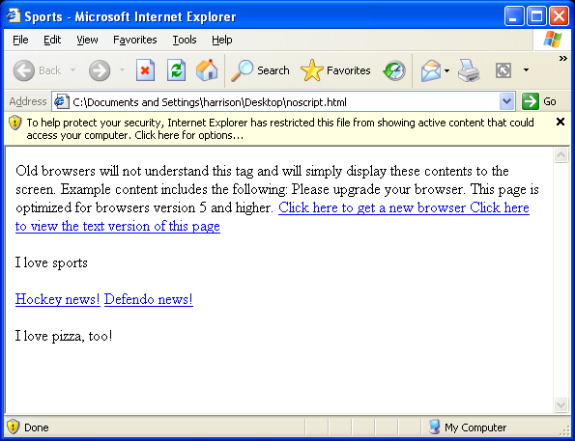
IE with javascript support shut off

Slide 37
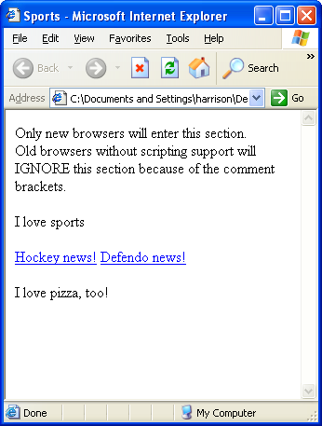
IE with javascript support shut on

Slide 38
writing to a web page with js
One of the first things we need to learn is how to write on a Web page.
Javascript works by manipulating objects (“things”) on a Web page and in a Web browser.
The Web page itself is called the “document” object, and it contains everything on the Web page.
When you want to write onto a document, use the document.write method (or document.writeln method).
A “method” is an action. Each object has different actions it can perform.
The document.write instruction must be inside a
<script type = “text/javascript”> section of code, like this:
  <script type = “text/javascript”>
  <!--
  document.write(“Hello from JavaScript”);
  // -->
  </script>

Slide 39
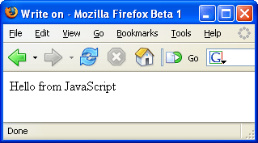
writing to a web page with js

Slide 40
writing to a web page with js
Note that we could have simply used HTML for this script. There is no need to use JavaScript for this example. By using JavaScript, our code is more complicated to read and write, and will require extra time for the browser to create the text (if it can handle JavaScript at all!). Only use a scripting language when plain HTML is insufficient.

Slide 41
writing to a web page with js
Once a document has been “written”, it is considered “closed”, and document.write will not work anymore.
Read lesson01 of the course notes to see how new text nodes can be added to a document once it has been “closed”.

Slide 42
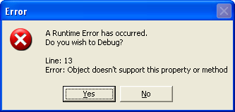
writing to a web page with js
Other things to note when using document.write:
Use quotation marks around the text you want outputted
Use double quotation marks or single quotation marks, either is fine
Put the quoted text inside brackets
End the instruction with a semicolon (true for all JavaScript statements!)
Use lowercase for document.write (not Document.Write, etc…)! The alphabetic case matters! Use lowercase for document and for write, or you will get errors such as this:

Slide 43
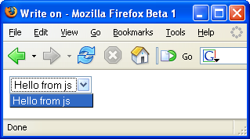
writing to a web page with js
We can output HTML using the document.write method too. Simply put the tags inside the quotation marks along with any regular text:
  <script type = “text/javascript”>
  <!--
  document.write(“<select><option>Hello from js</option></select>”);
  // -->
  </script>

Slide 44
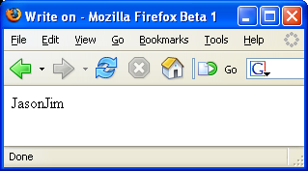
variables
A variable is a piece of data that is used to store changing information. A variable has a name and a value and a data type. A real life non-computer example can demonstrate:
We could create a variable called “firstname” that stores a person’s first name. I would set the value to “Jason”, Jim would set the value to “Jim”, Julie would set the value to “Julie”, etc.... The same variable (firstname) can have different values.
In a Web script, variables are used to keep track of all kinds of data. Here is a simple example:
  <script type = “text/javascript”>
  <!--
  var firstname = “Jason”;
  document.write(firstname);
  firstname = “Jim”;
  document.write(firstname);
  // -->
  </script>

Slide 45
variables
global variables are declared (created) with var (optional but good style)
writing to screen: no quotation marks: document.writeln(variable)
= sign assigns values to a variable
first character can be underscore or letter
the rest of the characters can be digits, underscores, or letters
no spaces in the name
You cannot use JavaScript keywords (parts of the language, itself) for variable names.
JavaScript variable names are case-sensitive (firstname is a different variable than Firstname)
value is “undefined” if not set with an equals sign var firstname
use meaningful names for variables
use quotation marks around strings assigned to variables (e.g. var name = “jason”)
a variable name can be very long (no official limit) but must fit on a single line
global variables are created when they are created, and die when the page is closed.

Slide 46
data types
Variables can contain different types of data:
strings quoted words
e.g. “Jason”, ‘hello everyone’, “6 and 7 and 8”, “”
numbers no quotation marks
e.g. 7.4, 5, 10000, 0, -5, 2e3 (2 x 10 ^ 3 = 2000)
e.g. 18 means base 10
e.g. 022 (leading zero) means 22 in base 8 (18 base 10)
e.g. 0x12 (leading zero x) means 22 in base 16 (18 base 10)
booleans true or false (only)
e.g. true, false
null means “no value”
e.g. null
A variable can hold any type of data and can change at any time. A variable containing a number can be changed to hold a string, a boolean, null, etc.... This is why JavaScript is called “weakly typed”.

Slide 47
quotes
There is virtually no difference between using single and double quotation marks in javascript. Here is where you use both:
To print "hello“ to the screen, including the double quotation marks:
document.writeln(‘ "hello“ ');

Slide 48
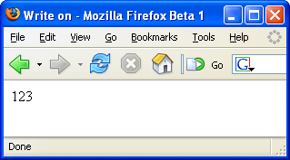
parseInt
To get the integer portion of a string which begins with a number, use the parseInt( ) function (instruction). There is also a parseFloat( ) function which works similarly, but with decimal numbers.
var address = “123 west 56th avenue”;
var avenue = parseInt(address);
document.write(avenue); // no quotation marks

Slide 49
indexOf
This is a very useful function which determines if a certain character or string exists inside another string. For example, if you ask the user for a URL, you can use indexOf to determine if “http://” or “www” or “.com” are inside the string.
The first character of a string is position zero. So a string with 8 characters such as “Harrison” is built like this:
var name = “Harrison”;
H a r r i s o n
0 1 2 3 4 5 6 7
Here is how indexOf works:
  name.indexOf(“H”) equals 0
  name.indexOf(“a”) equals 1
  name.indexOf(“r”) equals 2, the first instance of r occurs at position 2
  name.indexOf(“u”) equals -1, which means the search text is not found
  name.indexOf(“son”) equals 5, the starting position of the search text

Slide 50
+ concatenation +
To join together two strings use the plus sign + operator like this:
var variableName = “Harrison”;
document.write(“My last name is “ + variableName);
var age = 50;
document.write(“My age is “ + age);
var firstname = “Jason”;
var fullname; // current value is null
fullname = firstname + “ “ + variableName;

Slide 51
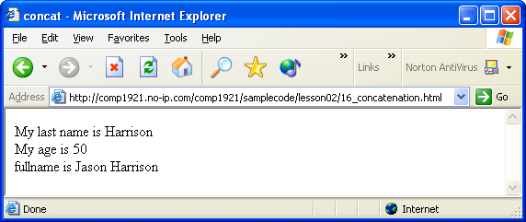
+ concatenation +

Slide 52
arithmetic operators
There are a number of arithmetic operators available in JavaScript:
Consider this example:
x = 20
y = 7
* multiplication e.g. x * y = 140
/ division e.g. x / y = 2.85714...
% modulus e.g. x % y = 6 (x and y must be integers)
+ addition e.g. x + y = 27
- subtraction e.g. x - y = 13
++ increment e.g. x++ (x equals 21 now)
-- decrement e.g. y-- (y equals 6 now)

Slide 53
if
Very often, a programmer writes pieces of code which should only be executed if some certain conditions apply. Real life examples could include:
if the distance to the store is two miles or less, I will walk
if it is not snowing, I will walk to the store
if the car is broken down and I have no bus fare, I will walk to the store
if it is sunny or cloudy, I will walk to the store
if (distance <= 2.0){
walk_to_store = true;
}
if (!snowing){
walk_to_store = true;
}
if (snowing == false){
walk_to_store = true;
}
if ((car_is_broken == true) && (have_bus-fare == false)){
walk_to_store = true;
}
if ((sunny == true) || (cloudy == true)){
walk_to_store = true;
}

Slide 54
logical and comparison operators
! not
|| or
&& and
== equal
!= not equal
> greater than
>= greater than/equal
< less than
<= less than/equal

Slide 55
logical and comparison operators
var salary = 29000.00;
if (salary > 50000.00)
{
document.write(“You make a good salary”);
}
else if (salary == 50000.00)
{
document.write(“You make 50 grand”);
}
else
{
document.write(“You need a raise”);
}

Slide 56
loops
Loops are used to repeat sections of code. Any section of code in a script can be executed zero times (for example, skip the code because it fails an “if” condition), one time, or many times (using a loop). To repeat one or more statements 100 times, a web author could simply write out the statement(s) 100 times in a row, like this:
document.write(“Hi, my name is Jason<br>”);
document.write(“Hi, my name is Jason<br>”);
document.write(“Hi, my name is Jason<br>”);
document.write(“Hi, my name is Jason<br>”);
document.write(“Hi, my name is Jason<br>”);
document.write(“Hi, my name is Jason<br>”);
document.write(“Hi, my name is Jason<br>”);
etc…

Slide 57
loops
This is quite inefficient.
What if we wanted to write this sentence a million times?
There is another alternative: use a loop.
There are several types of loops available for use in JavaScript.

Slide 58
for
The “for” loop repeats a section of code a number of times. The number of times to repeat is specified like this:
  for (counter = 0; counter < number_of_times_to_repeat; counter++)
  {
  all of this code
  is repeated
  }

Slide 59
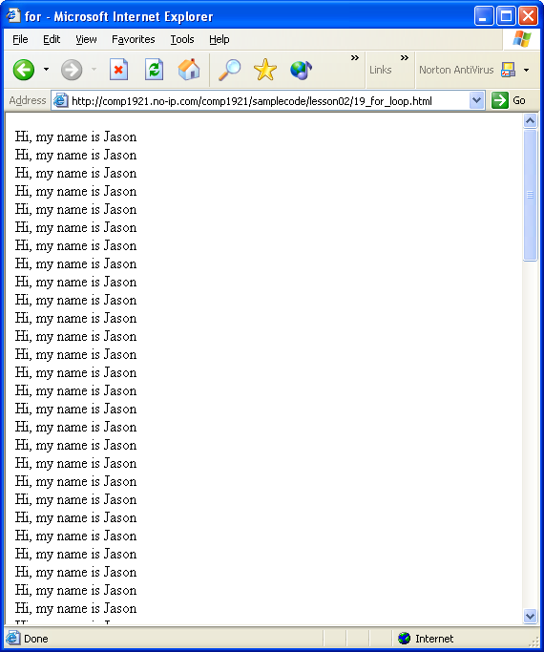
for
for (counter = 0; counter < 100; counter++)
{
document.write(“Hi, my name is Jason<br>”);
}

Slide 60
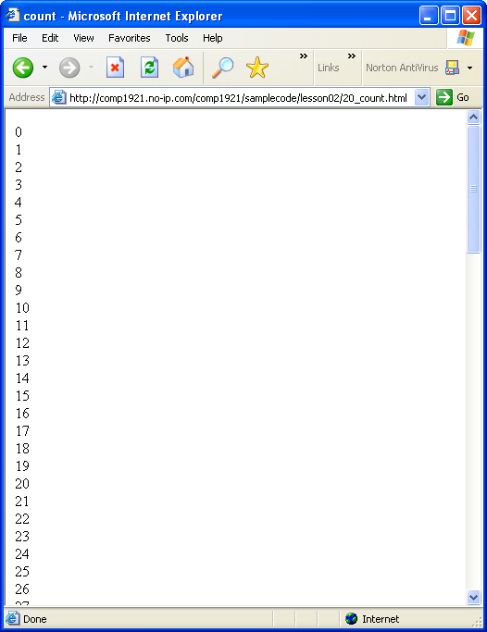
for
We can use the same loop to print out 100 numbers:
for (counter = 0; counter < 100; counter++)
{
document.write(counter + “<br>”);
}

Slide 61
break
At any time inside a loop, you can stop the loop and continue with the instructions after the end of the loop by using the break instruction, like this:
  for (counter = 0; counter < 100; counter++)
  {
  document.write(counter + “<br>”);
  if (counter == 30)
  {
  break;
  }
  }
document.write("end of loop");
This example would print the numbers from 0 to 30, then STOP the loop and continue with the document.write("end of loop"); instruction

Slide 62
dialog boxes
There are three message boxes which allow us to interact with users:
Alert
Confirm
prompt

Slide 63
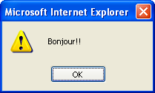
1. alert
<script type = "text/javascript">
<!--
alert("Bonjour!!");
// -->
</script>
Until the user presses the OK button, the script is “frozen”...when the OK button is pressed, the box disappears and the rest of the code can be run.

Slide 64
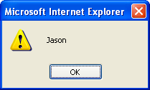
1. alert
You can use variables with alert dialogs:
<script type = "text/javascript">
<!--
var firstname = “Jason”;
alert(firstname); // no quotes
// -->
</script>

Slide 65
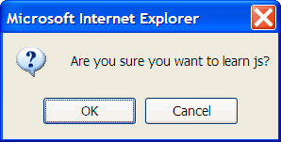
2. confirm
<script type = "text/javascript">
<!--
confirm("Are you sure you want to learn js?");
// -->
</script>

Slide 66
2. confirm
You can find out what the user clicked -- OK or Cancel -- by capturing it in a variable:
var userInput = confirm("Are you sure you want to learn js?");
if (userInput)
{
document.write(“You clicked OK”);
}
else
{
document.write(“You clicked Cancel”);
}

Slide 67
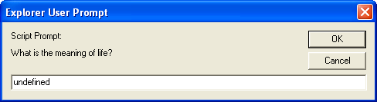
3. prompt
The prompt dialog allows you to get text input from your visitors
<script type = "text/javascript">
<!--
prompt("What is the meaning of life?");
// -->
</script>

Slide 68

3. prompt
You can also specify a default “answer” in the textbox.
Change the instruction from this:
prompt("What is the meaning of life?");
to this
prompt("What is the meaning of life?", “to be happy”);

Slide 69
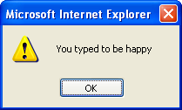
3. prompt
You can store the user’s prompt text in a variable like we did with the confirm dialog.
var userInput = prompt("What is the meaning of life?", “to be happy”);
alert(“You typed “ + userInput);

Slide 70
3. prompt
Here is a good check to determine if the user pressed the Cancel button. It works in most browsers:
var userInput = prompt("What is the meaning of life?", “to be happy”);
if ((userInput != “”) && (userInput != null))
{
alert(“You typed “ + userInput);
}
else
{
alert(“You pressed Cancel”);
}

Slide 71
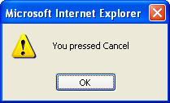
3. prompt
Notice that entering NO TEXT will also look like the Cancel button was pressed.

Slide 72
objects
JavaScript is an object-based language.
The interactions that JavaScript makes with the Web page are done through objects.
JavaScript has access to many built-in objects on a Web page, depending upon the browser type and version.
Each object has different properties and behaviours.
http://devguru.com is a good resource.

Slide 73
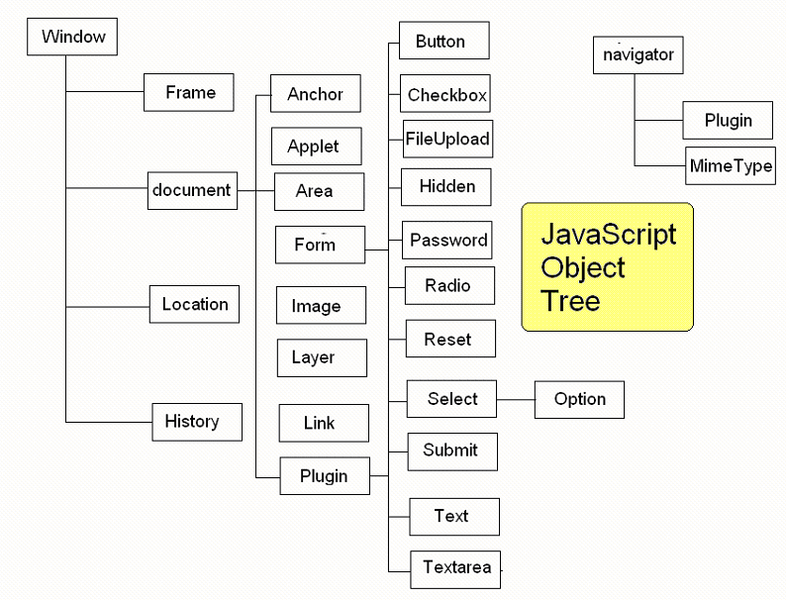

Slide 74
objects
For example, the “document” is a built-in object, which can be accessed and modified like this:
document.write(“Hello from JavaScript”);
There are many other built-in objects which are available for JavaScript to access and modify. Another built-in object is the window object:
window.open( );

Slide 75
window / document objects
The JavaScript window object contains all of the other objects we use.
The window object contains the document object, which itself contains all of the page’s HTML elements

Slide 76
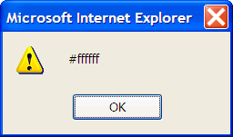
accessing objects and their properties
An object has properties which can be accessed and changed.
For example, the document object has a background color property called “bgcolor” which can be accessed like this:
<script type = "text/javascript">
<!--
alert(document.bgColor);
// -->
</script>

Slide 77
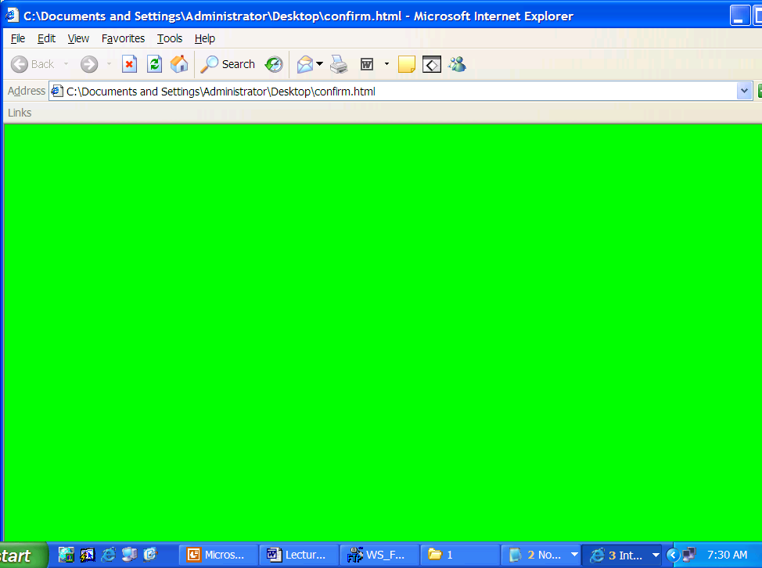
changing objects and their properties
The document object has a background color property called “bgcolor” which can be changed like this:
<script type = "text/javascript">
<!--
document.bgColor = "#00ff00";
// -->
</script>

Slide 78
document
In addition to bgColor, there are many other document object properties which can be accessed and modified

Slide 79
document
<html>
<head> <title>PROPERTIES</title></head>
<body bgColor = “red”>
<img name = “boy” src = “./jaden.jpg”>
<form name = “nameform”>
<input type = “text” name = “firstname”><br>
<input type = “text” name = “lastname”><br>
<input type = “submit” name = “go” value = “go”>
</form>
</body>
</html>
JavaScript can reference these objects and their properties using the “name” property as follows:
document.boy.src = “lion.jpg”;

Slide 80
document
Because the document object contains all of the HTML, HEAD, BODY objects (tags) and their elements, we can reference the “boy” image by talking about document.boy
This is an IMAGE object. The document object contains other objects.
The image object has two attributes set in the HTML code: name and src. These are available in the document.boy object as properties, referenced by document.boy.name and document.boy.src

Slide 81
dom level 0, dom level 1
This manner of accessing objects and their properties is actually using DOM Level 0 syntax. Virtually all browsers support DOM Level 0 syntax, so this type of code (document.boy.src = “lion.jpg”;) will work most of the time. Use the name attribute of the HTML tag and the “dot syntax”.
However, newer DOMs have newer rules for accessing objects and their properties. Newer DOMs access objects using the getElementById( ) method, like this:
document.getElementById(“boy”).src = “lion.jpg”;

Slide 82
getElementById – the id attribute
To properly use the getElementById( ) method, set both the name and id attributes of your HTML tags, like this:
<img name = "boy" id = "boy" src = "jaden.jpg">
This enables the script to work in all new browsers using the getElementById(“boy”) syntax.

Slide 83
ie 4+ - document.all
In Internet Explorer 4+, you can use document.all to access the HTML elements, like this:
alert(document.all[“boy”].name);
...but it does not work in Netscape:

Slide 84
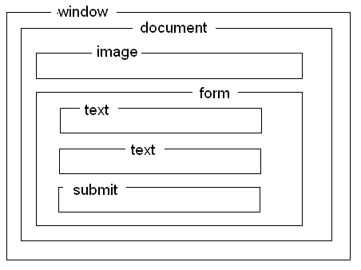
dom level 0
The DOM Level 0 also supports other ways of referencing objects. Imagine a diagram of our HTML code:
In JavaScript, an object that is nested inside another object has a “dot” separating them, like this:
window.document.form.text.value
...this refers to the text that is inside the text box inside the form on the document in the window. You can almost always omit the “window” reference, since JavaScript will imply it.

Slide 85
try it
change the value attribute of the submit button to “stop”. Show your instructor when you are finished. Remember to create an “id” attribute.
<html>
<head> <title>PROPERTIES</title></head>
<body bgColor = “red”>
<img name = “boy” src = “./jaden.jpg”>
<form name = “nameform”>
<input type = “text” name = “firstname”><br>
<input type = “text” name = “lastname”><br>
<input type = “submit” name = “go” value = “go”>
</form>
</body>
</html>

Slide 86
more document properties
property | description
alinkColor | color of active links.
bgColor | background color of the web page, set in the HTML <body> tag
cookie | value of a cookie.
defaultCharset | default character set
domain | domain name of the document server (e.g. “http://signalflare.ca”
embeds | array of document plugins
fgColor | text color of the web page, set in the HTML <body> tag
fileCreatedDate | date when the loaded HTML file was created
fileModifiedDate | date of the most recent change to the loaded HTML file
fileSize | size of the file, in bytes
fileUpdatedDate | date of the most recent update to the loaded HTML file
lastModified | date the file was last modified
linkColor | color of links in the document, specified in the HTML <body> tag

Slide 87
more document properties
location | full web address of the loaded HTML file
mimeType | array of mime types
nameProp
protocol | HTTP, FTP, etc....
readyState | state of the document: loaded, loading...
referrer | URL of the document which “sent” the visitor
security | security certificate status
title | from the head section’s <title> tag
URL | location of the current document.
vlinkColor | color of visited links, as specified in the HTML <body> tag

Slide 88
more objects and properties
http://devguru.com/technologies/javascript

Slide 89
methods
Methods allow us to interact with objects.
Methods are used to change objects.
With this example...
document.write(“hello”);
...write is a method of the document object. It is used to change (add text to) the document object.

Slide 90
methods
With this example...
window.open( );
...open is a method of the window object. It is used to change (create) a window object.

Slide 91
methods
Each type of object has a different set of methods available to it, just like each type of object has a different set of properties available to it.
For instance, a “title” has no “src”, but an image does. To use a method to change an object, specify the method like this:
document.method( )
...sometimes there are contents inside the parentheses, (brackets) and sometimes the parentheses are empty.

Slide 92
document methods
method | description
document.close( ) | closes output stream used to create a new document object
document.elementFromPoint(x, y) | returns the object located at point x, y in the HTML document
document.getSelection( ) | gets the selected text (if any)
document.open([mimeType]) | opens a new document object with the optional MIME type
write([“text”], [variables]) | writes whatever is inside the brackets, to the document
writeln([“text”], [variables]) | writes whatever is inside the brackets, to the document, followed by a newline character

Slide 93
document methods
http://devguru.com/technologies/javascript/10629.asp

Slide 94
events
JavaScript can detect and react to certain events.
We can write event handlers to tell the browser what should be done when an event occurs.
For instance, when the mouse rolls over an image, javascript can react (e.g. by changing the image, or the cursor).

Slide 95
events
onAbort
onBlur
onChange
onClick
onDblClick
onDragDrop
onError
onFocus
onKeyDown
onKeyPress
onKeyUp
Onload
onMouseDown
onMouseMove
onMouseOut
onMouseOver
onMouseUp
onMove
onReset
onResize
onSelect
onSubmit
onUnload

Slide 96
event handlers
To respond to a document event, write an event handler.
Document event handlers can be set in the body tag.
<head><title>The main event</title></head>
<body bgcolor = “beige” onclick = “alert(‘clicked’);”>
Click me.
</body>

Slide 97
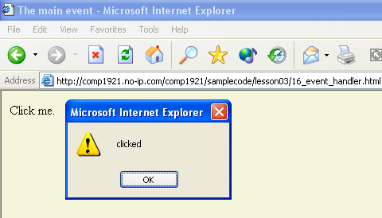
event handlers

Slide 98
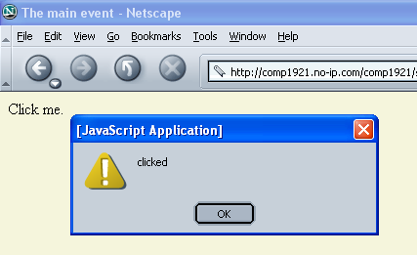
event handlers

Slide 99
more objects
So far we have only been concentrating on the document object.
There are many other useful objects that can be referenced by JavaScript.
Anchor | Checkbox | Frame | Link | Option | Select
Applet | Date | Function | Location | Password | String
Area | Document | Hidden | Math | Radio | Submit
Array | Event | History | Navigator | RegExp | Text
Boolean | FileUpload | Image | Number | Reset | Textarea
Button | Form | Layer | Object | Screen | Window

Slide 100
test
Write a script that has an image in it. When the image is double-clicked, change the image’s height and width properties to larger values. Use the ondblclick event handler as an attribute of your image tag, similarly to how this code set up its event handler:
http://signalflare.ca/comp1911/samplecode/lesson03/16_event_handler
You can change the height and width of an image similar to how this script changes the src of an image:
http://signalflare.ca/comp1911/samplecode/lesson03/10_document_img_src.html

Slide 101
functions
A “function” is an instruction.
JavaScript has plenty of built-in functions.
You can also write your own.
Almost all of the time, we put our JavaScript code into functions.
A function groups together lines of code. For example, when the user comes to your Web site, you can use a function to do several lines of code such as (1) write "hello" to the screen, (2) flash an image at them, and (3) tell them what's new on the site...whatever you want! Just put all the code into a single function.

Slide 102
functions
Functions go inside the <script language = "javascript"> </script> tags.
All of this goes into the <head> section of your Web page, so your instructions are loaded and “ready to go” before the body is loaded..
For each different behavior you want in your Web page, make a separate function.
Functions must be set to event handlers, otherwise they will never be used.
For example, I know self-defence, but I never use it. I know French, but I never use it.

Slide 103
creating a function – step 1 of 5
1. First use the word function.
function
This tells JavaScript that you are creating a function.

Slide 104
creating a function – step 2 of 5
Then give it a name that indicates its purpose (use letters only):
function welcomeVisitorToWebSite

Slide 105
creating a function – step 3 of 5
Then put round brackets after the name.
All functions have round brackets after the name.
Sometimes there is data between the round brackets.
We won't put data in ours yet.
function welcomeVisitorToWebSite()

Slide 106
creating a function – step 4 of 5
Then put curly brackets{ }.
All of the code for your function goes inside these squiggly brackets.
All of the lines of code that you want grouped together goes inside these squiggly brackets.
function welcomeVisitorToWebSite()
{
// empty so far
}

Slide 107
creating a function – step 4 of 5
In this example, the function will simply greet the user.
function welcomeVisitorToWebSite()
{
document.writeln("<h1>BONJOUR! </h1>");
document.writeln("<p>How are you today?</p>");
}

Slide 108
creating a function – step 5 of 5
The final thing we have to do is USE this function! When is a good time to welcome a visitor?
We can use this function whenever we want. We can use it once, or a million times, or never.
Question: which EVENT do we want to trigger a "welcome" function? Do we want to show this welcome message when the user leaves the site? Probably not. When they click a button? When they put their mouse over an image? If you don't CALL the function, it will never be used at all!

Slide 109
creating a function – step 5 of 5
Let's call the function, to welcome the user, when the page first loads.
<body onload = "welcomeVisitorToWebSite();">
</body>
This function is used as soon as the page loads (i.e. right away)

Slide 110
try it
Instead of using the function welcomeVisitorToWebSite() when the page loads, use it when they click a button.
Do not call the function when the page loads anymore.
You must insert a button that calls the function when it is clicked.

Slide 111
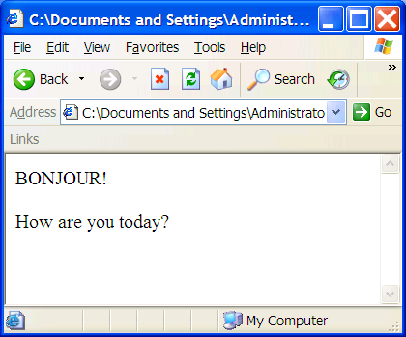
using our function

Slide 112
custom js functions
<script type = “text/javascript”>
<!--
function functionNameNoSpaces() {
what your function does
goes right here
}
// -->
</script>

Slide 113
custom js functions
<script type = “text/javascript”>
<!--
function introduceJason() {
document.write(‘i am jason’);
alert(‘jason says hello’);
}
// -->
</script>

Slide 114
using custom js functions
<head>
<script type = “text/javascript”>
<!--
function introduceJason() {
document.write(‘i am jason’);
alert(‘jason says hello’);
}
// -->
</script>
</head>
<body onload=“introduceJason();”>

Slide 115
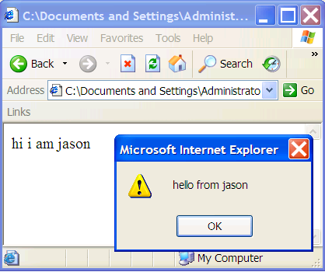
using custom js functions

Slide 116
custom js functions with parameters
<script type = “text/javascript”>
<!--
function functionNameNoSpaces(variable) {
what your function does
goes right here
use variable in here too
e.g. alert(variable)
}
// -->
</script>

Slide 117
custom js functions with parameters
<head>
<script type = “text/javascript”>
<!--
function introducePerson(personsName) {
document.writeln(‘hi i am “ + personsName);
alert(‘hello from’ + personsName);
}
// -->
</script>
</head>
<body onload=“introducePerson(‘tony baloney’);”>

Slide 118
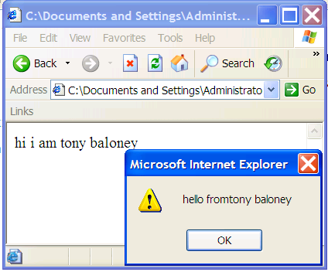
custom js functions with parameters

Slide 119
custom js files
It is common to put all of your custom functions (the ones you created) into a separate file.
Name the file with a .js file extension (e.g. myfunctions.js).
Put your JavaScript code in this file; do not include opening and closing SCRIPT tags in the myfunctions.js file!
use these tags in your HTML file:
<SCRIPT LANGUAGE="JavaScript" SRC="myfunctions.js">
</SCRIPT>
Note that some old browsers (e.g. Navigator 2.x and Explorer 3.x) cannot load external JavaScript files!

Slide 120
case study – image rollovers
Events: onmouseover, onmouseout
The image must have an id attribute
Use the getElementById() method
Create a function “changeImage()” (or something similarly named)
Call your function with the onmouseover, onmouseout events.
Example:
http://signalflare.ca/comp1911/samplecode/lesson04/04_rollover_change_back.html

Slide 121
case study – text rollovers
Very similar to image rollovers.
Use the style.color attribute.

Slide 122
browser detection (yuck)
However, there are still a couple of major problems with this script:
older browsers do not support dynamic imaging. The first browsers that allowed authors to change images “on the fly” were Netscape Navigator 3 and Internet Explorer 4
some browsers that do support dynamic imaging still do not support the getElementById( ) method.
Let’s fix our script to take the user’s browser into consideration.

Slide 123
navigator
JavaScript has a built-in navigator object which has information about the user’s browser. The navigator object has three properties which are very useful:
appName official name of the browser application: “Netscape” for Netscape browsers and “Microsoft Internet Explorer” for Internet Explorer browsers.
appVersion information about the browser's version (not necessarily correct!)
userAgent information about the browser's version, platform, and the country for which the browser is released
The appName, appVersion and userAgent properties are available in all browsers since Netscape 2 and Internet
Explorer 3.

Slide 124
navigator
There are other properties and methods available “inside” the navigator object, but these three properties are the most useful in determining information about browsers and platforms.
userAgent is the most important since it is supported by all browsers and gives the most complete information.

Slide 125
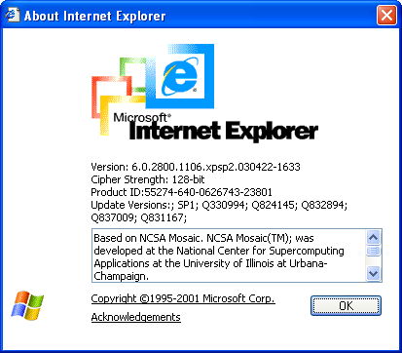
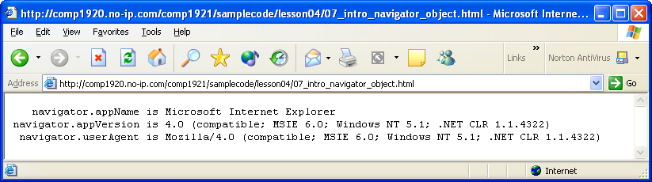
navigator
Microsoft Internet Explorer 6.0:

Slide 126
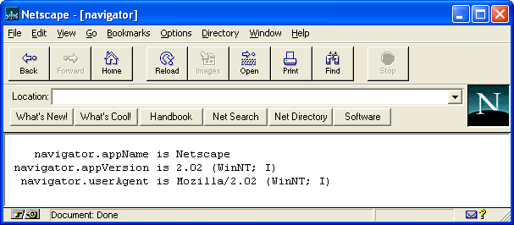
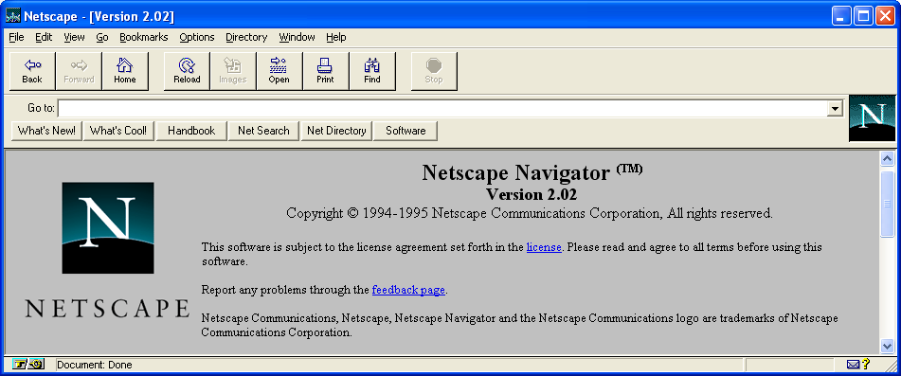
navigator

Slide 127
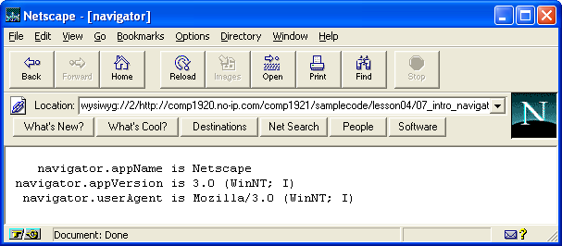
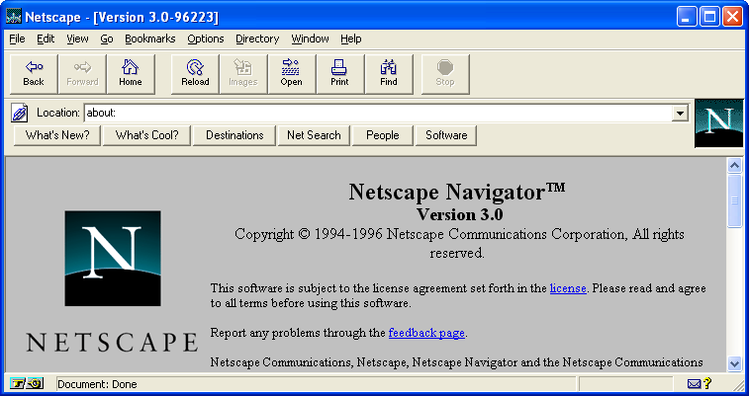
navigator

Slide 128
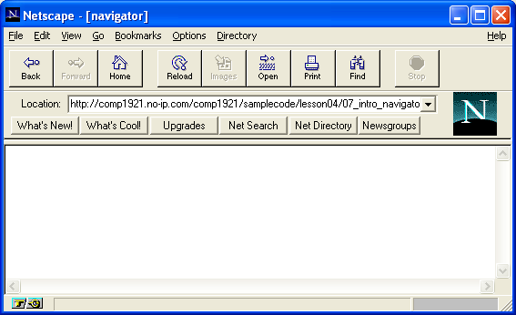
navigator
Netscape Navigator 1.0 : JavaScript is not supported!

Slide 129
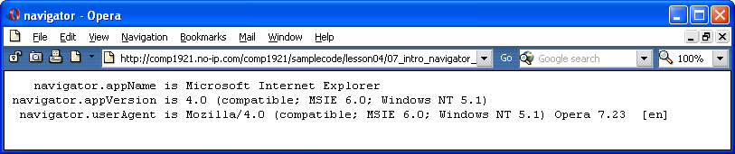
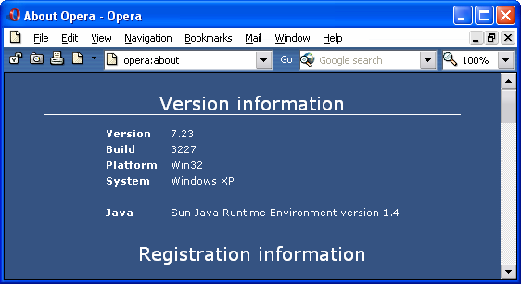
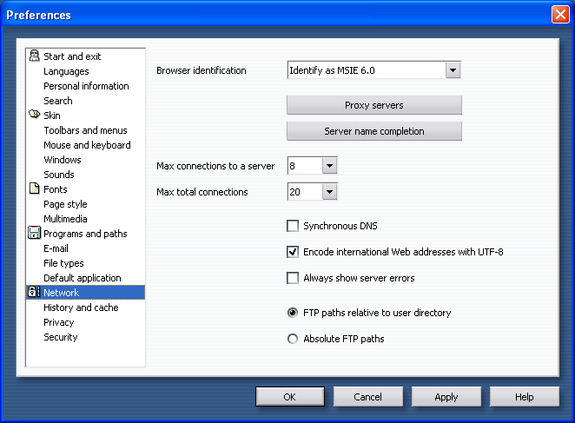
navigator

Slide 130
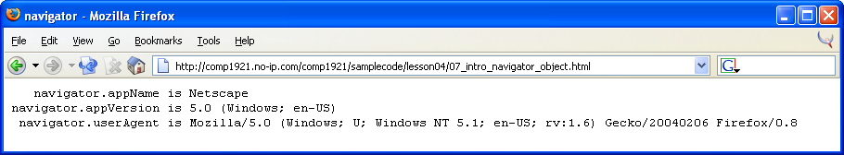
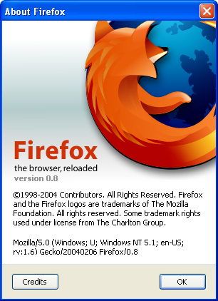
navigator

Slide 131
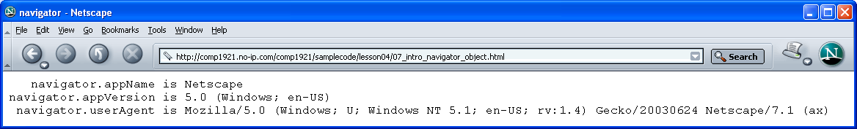
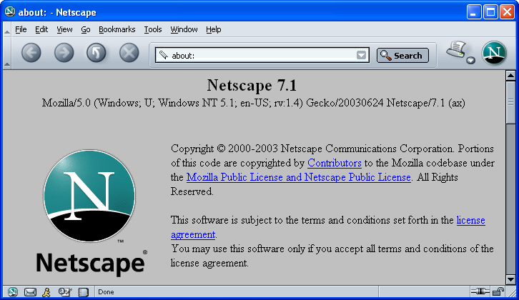
navigator

Slide 132
navigator problems
Take a look at some of the values listed above. The appVersion property does not accurately match the actual browser version! Instead, use the userAgent property to find out exactly what browser is being used.
Note: browser detection is not a good way to customize scripts! Sometimes (rarely) it is necessary to detect exactly which browser is being used, but usually object detection is the best way to code. We will learn browser detection (browser sniffing), but in our actual scripts, we will use object detection.
Note that browser detection is not perfect; for example, JavaScript cannot reliably detect AOL browsers because the Internet Explorer which runs the AOL browser does all of the JavaScript, and can announce itself as any version of Explorer. Use a server side detection script to detect AOL browsers with 100% certainty.

Slide 133
navigator problems
As seen with the Opera example above, most minor browsers offer the ability to change identification strings, to identify themselves as one of the major browsers (Netscape/IE).
One of the reasons for this is that many authors write scripts with browser detection to ensure their pages are accessible only in Internet Explorer (or Netscape).
Minor browsers would be denied access to such pages, so they identify themselves as one of the major browsers in order to get access.
The Opera browser always has “Opera” in its userAgent string (see above), but other minor browsers (e.g. Safari, iCab) totally mask their true identity.

Slide 134
navigator problems
The userAgent string almost always starts with “Mozilla”, the name of the original Netscape code engine.
The original Netscape browsers fancier capabilities than all other browsers, so many authors wrote browser-detection scripts which looked for “Mozilla” in the userAgent, and sent these browsers to the fancy versions Web pages.
Other browsers were sent to plain versions of the Web pages. In order to gain access to the fancy pages, other browsers added “Mozilla” to the start of their userAgent string too.
This is still commonly done today.

Slide 135
navigator problems
Non-Netscape browsers usually have their real name in the string too: e.g. “MSIE”, “Opera”, etc..., and added the word “compatible” right after the “Mozilla” version.
This indicates that the browser is not in fact “Mozilla”, but is Mozilla-compatible.

Slide 136
navigator problems
The userAgent also contains the “version number” of the browser. All browsers (except Netscape) include the genuine version number immediately after their actual browser name, separated by either a space or a slash:

Slide 137
navigator problems
For Netscape browsers 1 - 6, use the number that comes after “Mozilla” instead, because these browsers do not identify themselves as “Netscape”, but rather only as “Mozilla”:

Slide 138
platform detection
Detecting the user’s operating system is possible using the userAgent string. Microsoft Windows is identifed by Internet Explorer as “Windows” and is usually identified by Netscape as “Win”.
Therefore, we can search for “Win” in the userAgent. Macinstosh operating systems are identified as “Mac”, Unix is “X11”, and Linux is “Linux”.

Slide 139
use object detection
A browser checking script would have to be constantly revised as new browsers are released.
Browser detection is not a good way to customize scripts!

Slide 140
object detection
Object detection (and method detection) involves finding out what capabilities a browser has. This is a much better way to code. Instead of determining “if this is Netscape 6 or 7, do this...if it’s Netscape 4, do this...if it’s Internet Explorer 4, do this....”, your script can determine “if this browser supports dynamic imaging, do this...if this browser supports the newest DOM, do this...”.
Object detection means using JavaScript to detect whether the user’s browser supports a particular object.

Slide 141
object detection
Use if statements to detect objects, like this:
if (document.images)
{
document.write(“This browser supports dynamic imaging”);
}
else
{
document.write(“This browser does not support dynamic imaging”);
}

Slide 142
object detection
The syntax is:
if (object) …
// okay good
else
// not supported

Slide 143
object detection
This statement...
if (document.images)
...will only evaluate to true if the images object is defined (i.e. if the browser supports it). This is object detection. Object detection works in all browsers which support JavaScript.

Slide 144
preventing error messages
On professional Web sites, JavaScript errors are a very bad thing. Even if you work hard to ensure that your scripts are handled fine by all browsers, eventually something will go wrong, and an error will occur. However, it is possible to stop all JavaScript error messages even if an error actually occurs. Following is the technique; put this code directly in the head section of your document:
<script language = "javascript" type = “text/javascript”>
<!--
function stopError() {
return true;
}
window.onerror = stopError;
// -->
</script>

Slide 145
plugin detection
Typically, JavaScript code that determines what version of the plugin is installed looks at the mimeTypes array that is part of the navigator object. Every plugin exposes a description string that typically includes the plugin's name and version number. The Flash plugin's description string uses a standard versioning nomenclature that can then be parsed for meaningful information.

Slide 146
plugin detection
function getPlugins(){
document.writeln("<TABLE BORDER=1><TR VALIGN=TOP>",
"<TH ALIGN=left>i", "<TH ALIGN=left>name",
"<TH ALIGN=left>filename", "<TH ALIGN=left>description", "<TH ALIGN=left># of types</TR>");
for (i=0; i < navigator.plugins.length; i++) {
document.writeln("<TR VALIGN=TOP><TD>", i, "<TD>",
navigator.plugins[i].name, "<TD>", navigator.plugins[i].filename,
"<TD>",navigator.plugins[i].description, "<TD>",
navigator.plugins[i].length, "</TR>");
}
document.writeln("</TABLE>")
}

Slide 147
plugin detection
A great reference:
http://docs.sun.com/source/816-6408-10/plugin.htm

Slide 148
timers
All animation in JavaScript is done using timers.
There are several timer methods used for timers.
setTimeout
The setTimeout method calls a JavaScript statement after waiting for a specified number of milliseconds. Often the “JavaScript statement” is a function that you created. Here is the format:
var timerId = setTimeout(“js_function", number_of_milliseconds_to_wait);

Slide 149
timers
var timerId = setTimeout("alert('3 seconds is up!')", 3000);
This creates a timer variable called timerId. This timer variable is useful later in the script. Three seconds (3000 milliseconds) after the “timesup” function is called, an alert dialog box will appear.

Slide 150
timers
<head>
<script type = "text/javascript" language = "javascript" >
<!--
function timesup()
{
var timerId = setTimeout("alert('3 seconds is up!')", 3000);
}
// -->
</script>
</head>
<body>
<p>Click the image and wait 3 seconds for a surprise:</p>
<img src = "./lion.jpg" id = "animalImage" onclick = "timesup()";
</body>

Slide 151
ongoing timers – setInterval
<head>
<script type = "text/javascript" language = "javascript" >
<!--
function timesup()
{
alert("Surprise!");
}
// -->
</script></head><body>
<p>Click the image and wait 3 seconds for a surprise:</p>
<img src = "./lion.jpg" id = "animalImage" onclick = "setInterval('timesup()', 3000);”>
</body>
Every 3000 milliseconds (= 3 seconds) the function timesup( ) will be called.

Slide 152
stopping an ongoing timer - clearInterval
To stop the setInterval function from being called, use the clearInterval( ) method. Declare a timerId variable that is accessible to the whole script, like this:
<head>
<script type = "text/javascript" language = "javascript" >
<!--
var timerId;
function timesup(){
alert("Surprise!");
}
function startHere(){
timerId = setInterval('timesup()', 3000);
}
// -->
</script></head><body>
<p>Click the image and wait 3 seconds for a surprise:</p>
<img src = "./lion.jpg" id = "animalImage" onclick = "startHere()”>
<input type = “button” value = “stop timer” onclick = “clearInterval(timerId);”>
</body>

Slide 153
timers and old browsers
NOTE:
You can use object detection to protect your code against older browsers. Change the code from this...
timerId = setInterval('timesup()', 3000);
...to this...
if (window.setInterval)
{
timerId = setInterval('timesup()', 3000);
}
else
{
alert("this browser doesn't support the setInterval method");
}

Slide 154
animation
<head>
<script type = "text/javascript" language = "javascript" ><!--
function moveObject()
{
document.getElementById("animate").style.left = parseInt(document.getElementById("animate").style.left)+5+"px";
document.getElementById("animate").style.top = parseInt(document.getElementById("animate").style.top)+5+"px";
}
// --></script></head>
<body onload = "setInterval('moveObject()', 1000);">
<img src = "./lion.jpg" id = "animate" style = "position:absolute; top:0; left:0;">
</body>

Slide 155
comp1911
client side web scripting
using javascript
day 2

Slide 156
Learning Outcomes
dates and times
form validation
Regex (theory only)
cookies
windows
scrollers
menus
animation
finding javascript online

Slide 157
dates and times
javascript can determine the date and time on the client’s (browser’s) computer
Javascript can also create dates and times
This can be used for display purposes, or to calculate spans of time
e.g.:
  “5 more days until January 1”,
  “you are 777600000 seconds old”

Slide 158
dates and times
JavaScript’s Date object and its methods are very useful for working with dates and times.
This is the technique to get the current date stored into a Date variable:
var today = new Date( );
You can reference all of the Date object methods available for the today variable. On the next slide is a list of the most common Date object methods. Here is a simple example of how to use the Date object and its methods:
  function writeDate()
  {
  var today = new Date();
  document.write(today);
  }

Slide 159
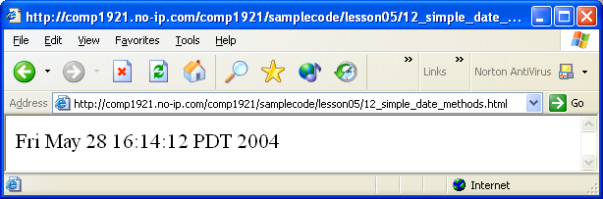
dates and times

Slide 160
dates and times
getDate | returns an integer (1 - 31) for the day of the month of the (local time) date.
getDay | returns an integer (0 for Sunday ... 6 for Saturday) representing the day of the week.
getFullYear | returns an integer representing the four-digit value of the year of a date.
Lots more here:
http://devguru.com/technologies/javascript/10585.asp

Slide 161
dates and times
function writeDate()
{
var today = new Date();
document.write(“DAY = “ + today.getDay());
document.write(“MONTH = “ + today.getMonth());
document.write(“DATE = “ + today.getDate());
document.write(“YEAR = “ + today.getFullYear());
document.write(“HOURS = “ + today.getHours());
document.write(“MINUTES = “ + today.getMinutes());
document.write(“SECONDS = “ + today.getSeconds());
}

Slide 162
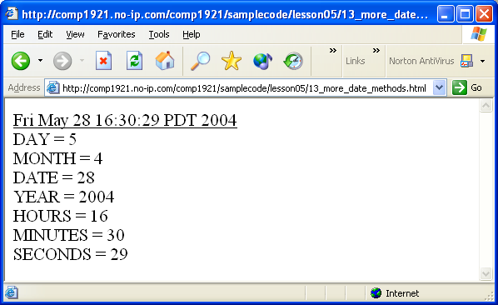
dates and times

Slide 163
dates and times
Finding the Number of Days Between Dates
Here is one technique to determine the number of days between two dates. This example script will determine how many days are between July 5, 1990 and July 5, 1999. We can do this in four steps:
Create a Date variable for the July 5, 1990. Use the getTime( ) method to determine the number of milliseconds from midnight January 01, 1970 to July 5, 1990.
Create a Date variable for the July 5, 1991. Use the getTime( ) method to determine the number of milliseconds from midnight January 01, 1970 to July 5, 1991.
Subtract the 1990 getTime( ) value from the 1991 getTime( ) value to get the number of milliseconds between the two dates.
Convert this milliseconds value to a days value.

Slide 164
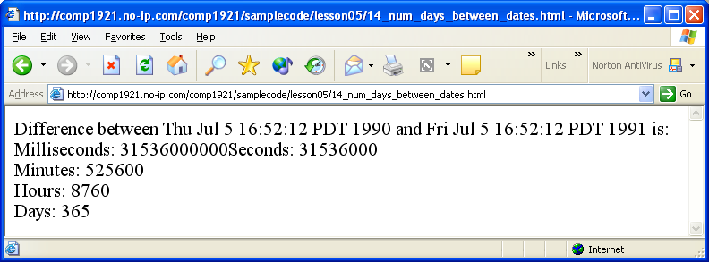
dates and times

Slide 165
dates and times
Self Test:
Write a script that determines how many seconds have passed since a document was last modified. This date is stored in the document.lastModified property.
Self Test:
Use a timer and the Date object to create a Web page that acts like a clock, updating itself every second, with the current time displayed showing the day of the week, date, hours, minutes, and seconds, like this:
Today is Monday, May 1, 2006 12:10:05 pm

Slide 166
form validation
Perhaps the most common use for javascript is form validation
Javascript can determine the values of form elements by using this technique: getElementById(‘elementid’).value
Javascript can change the values the same way:
getElementById(‘elementid’).value = ‘xyz’;

Slide 167
form validation
Javascript can manipulate forms too:
  make elements visible/invisible
  make elements take/lose the focus
  make elements disabled/enabled
  Etc….

Slide 168
focus()
When an object has the focus, that object will accept input from the keyboard. When an object does not have the focus, it is said to be “blurred”.
When a form is loaded, it is nice for the focus to be placed “automatically” on the first form input requiring user input.

Slide 169
focus()
<html><head> <title>onformload focus</title>
<script type = "text/javascript" language = "javascript">
<!--
function focusMe() {
document.getElementById("firstname").focus();
}
// -->
</script>
</head>
<body onload = "focusMe();">
<input type = "text" id = "firstname" name = "firstname" value = "First name">
</body></html>
This example would “automatically” put the focus on an element called “firstname”

Slide 170
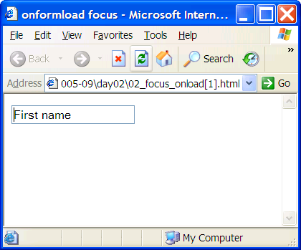
focus()

Slide 171
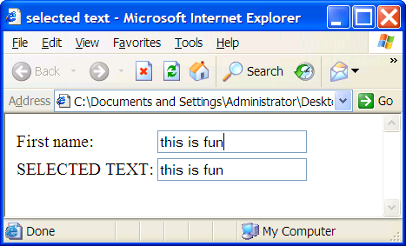
copying text

Slide 172
copying text
<html><head> <title>selected text</title>
<script type = "text/javascript" language = "javascript">
<!--
function copy(textObject) {
document.getElementById("selected").value = textObject.value;
}
// -->
</script>
</head>
<body>
<input type = "text" id = "firstname" name = "firstname" value = "First name" onkeyup = "copy(this);">
<input type = "text" id = "selected" name = "selected">
</body></html>

Slide 173
select()
The select( ) method is supported by the following objects:
  Password
  Text
  Textarea
This method “automatically” selects the text in a password, text, or textarea object.
It is useful when a script sets the focus on an object, to also select the text in that object, so when the user starts typing, they will overwrite the selected text in that object.
The code is the same as focus() but use select()

Slide 174
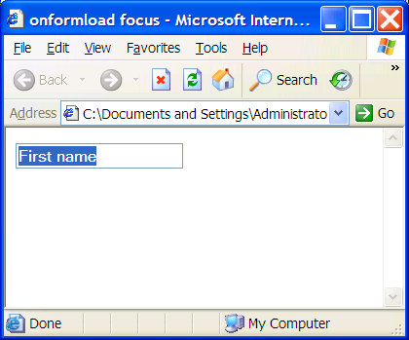
select()

Slide 175
fancy selects
Fancy features are possible using the onselect() event handler:

Slide 176
fancy selects
<html><head> <title>selected text</title>
<script type = "text/javascript" language = "javascript">
<!--
function copy(textObject) {
var selectedText = document.selection;
if (selectedText.type == 'Text') {
var newRange = selectedText.createRange();
textObject.focus();
document.getElementById("selected").value = newRange.text;
}
}
// -->
</script></head><body>
<input type = "text" id = "sometext" name = "sometext" value = "highlight this" onselect =
"copy(this);">
<br>
<input type = "text" id = "selected" name = "selected">
</body></html>

Slide 177
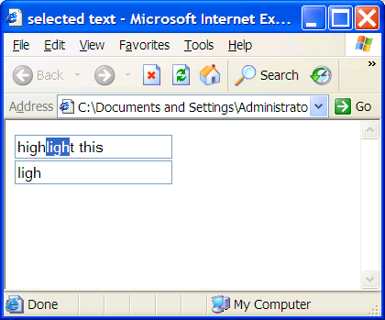
fancy selects

Slide 178
data validation - email
Validate form data using the indexOf( ) method
We have already studied the indexOf( ) String method. It is very useful in validating user information too. Recall that stringObject.indexOf(“specified text”) returns “-1” if the specified text is not found in stringObject. The following example does a simple check that a user has entered a valid email address.
When should you validate the data typed by a user? After the user has typed in some text, and they exit the text element. When the text element loses focus, the onblur event handler gets called.
<input type = "text" id = "email" name = "email" value = "Email address"
onblur = "validate(this);"
>
function validate(textObject){
var text = document.getElementById(textObject.id).value;
if (text.indexOf("@") == -1) {
alert("No @ sign, not a valid email!");
}
if (text.indexOf(".") == -1) {
alert("No dot, not a valid email!");
}
}

Slide 179
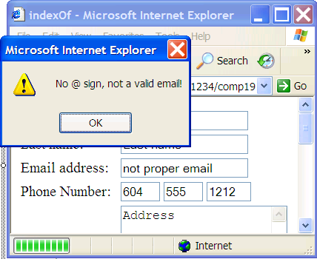
data validation - email

Slide 180
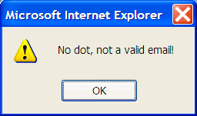
data validation - email

Slide 181
data validation - submit
This is another useful event handler that should validate data. This event handler is supported only by Form objects.
If you want to validate the information in the form and only allow it to be submitted if it meets your requirements, put a “return” statement inside the event handler which returns false if invalid data is found (and which returns true if only valid data is found):

Slide 182
data validation - submit
function validateEntireForm(formObject)
{
if (found some error)
{
return false;
}
}
<form onsubmit = "return validateEntireForm (this);">

Slide 183
data validation - submit
<html><head> <title>onsubmit</title>
<script type = "text/javascript" language = "javascript">
<!--
function validateEntireForm(formObject) {
var text = document.getElementById("email").value;
if (text.indexOf("@") == -1) {
alert("No @ sign, not a valid email!"); return false;
}else if (text.indexOf(".") == -1) {
alert("No dot, not a valid email!"); return false;
}else{
alert("@ and dot, looks like a valid email!"); return true;
}
}
// -->
</script></head><body>
<form id = "userinfoform" name = "userinfoform" action = "http://www.defendo.com" onsubmit="return validateEntireForm(this);">
Email address:<input type = "text" id = "email" name = "email" value = "Email address" ><br>
<input type = "submit" id = "submitbutton" name = "submitbutton" value = "Send data">
</form></body></html>

Slide 184
data validation - submit
Another simple, useful validation technique is to check that the user has entered data that matches the datatype, range, and length that you are expecting.
For instance:
American zip codes are length 5, all digits
Canadian post codes are length 6, alternating letter digit letter digit letter digit
Phone numbers are 7 or 10 digits
Social Insurance Numbers are 9 digits
Dates are often number in formats such as YYYY-MM-DD
Ages are typically 0 to 100 or so

Slide 185
data validation - submit
Let’s validate an entire form when the user presses the submit button. The best way to do this is to use the onsubmit event handler. Call a validation function and pass the form variable as a parameter:
<form id = "userinfoform" name = "userinfoform" action = "http://www.defendo.com" onsubmit="return validateEntireForm(this);">

Slide 186
isNaN
The isNan function means “is not a number”; it returns true if the argument is not a number and false if the argument is a number
View the example here, which so far only validates the zip code portion of the form:
signalflare.ca/comp1911/samplecode/lesson08/01_validate_datatype_range_length.html

Slide 187

isNaN

Slide 188

isNaN

Slide 189
required fields
If (document.getElementById(‘someTextBox’).value.length < 1){
alert(‘hey! You typed nothing!’);
}

Slide 190
disabled fields
Use the single word "disabled" (this is HTML not JavaScript) to disable a field.
This removes it from the tab order. Disabled select boxes don't "drop down".
document.getElementById(‘whatever’).disabled = true;

Slide 191
submitting using the button only
<html><head> <title>validation</title><script type = "text/javascript" language = "javascript">
<!--
function onKeyPress () {
var keycode;
if (window.event){
keycode = window.event.keyCode;
}else if (e){
keycode = e.which;
}else{
return true;
}
if (keycode == 13) {
alert("Please Click on the Submit button to send this"); return false;
}
return true;
}
document.onkeypress = onKeyPress;
// -->
</script></head><body>
<form id = "userinfoform" name = "userinfoform" action = "http://www.defendo.com">
Zip code:<input type = "text" id = "zipcode" name = "zipcode"><br>
<input type = "submit" id = "submitbutton" name = "submitbutton" value = "Send data">
</form></body></html>

Slide 192
regular expressions
Used for pattern matching
var pattern=/php/i
pattern.test("PHP is your friend") //returns true
But this just looks for the exact text “php”
Regex are much more flexible than that
Look for patterns of text, not exact literal text

Slide 193
next up
Cookies
Windows
Dynamic menus, scrollers, animation

Slide 194
cookies
A cookie is a little text file that is used to store (remember) data. This little text file is stored on the browser’s computer...each browser stores cookies in different directories.
Typical example of how cookies are used:
a visitor fills in form fields with data
the script stores these values inside cookies
on future visits to the same web page, the user does not have to fill in the form fields; the script can get the values from the cookie, and fill in the form fields “automatically”.
Cookies were first invented by Netscape.

Slide 195
cookies
A cookie has several properties that can be set; only the name and value are required:
name name of the cookie
value value of the cookie
expiry date default is when the browser closes
path default is the script path
domain default is the script domain
secure true if requires secure transmission

Slide 196
cookies
For reasons of security, there are limitations set on cookies. According to Netscape's official documentation, a client can store a maximum of 300 cookies. Each cookie can be up to 4 kilobytes (i.e. 4000 characters), including the name and value fields. A maximum of 20 cookies per server or domain are allowed.
Actually, to use cookies in JavaScript, we can use the following user-defined functions.
Copy/paste these into the head section of documents (or in its own JavaScript file, e.g. cookies.js).

Slide 197
cookies
You can copy/paste these functions from the following script:
http://signalflare.ca/comp1911/samplecode/lesson09/01_cookie_functions.html

Slide 198
setcookie
function setCookie(name, value, expires, path, domain, secure)
{
var curCookie = name + "=" + escape(value) +
((expires) ? "; expires=" + expires.toGMTString() : "") +
((path) ? "; path=" + path : "") +
((domain) ? "; domain=" + domain : "") +
((secure) ? "; secure" : "");
document.cookie = curCookie;
}

Slide 199
getcookie
function getCookie(name) {
var dc = document.cookie;
var prefix = name + "=";
var begin = dc.indexOf("; " + prefix);
if (begin == -1) {
begin = dc.indexOf(prefix);
if (begin != 0) {
return null;
}
} else {
begin += 2;
}
var end = document.cookie.indexOf(";", begin);
if (end == -1){
end = dc.length;
}
return unescape(dc.substring(begin + prefix.length, end));
}

Slide 200
deletecookie
function deleteCookie(name, path, domain)
{
if (getCookie(name)) {
document.cookie = name + "=" +
((path) ? "; path=" + path : "") +
((domain) ? "; domain=" + domain : "") +
"; expires=Thu, 01-Jan-70 00:00:01 GMT";
}
}

Slide 201
cookies
The expiry date is stored in “number of milliseconds”. To create a cookie called “firstname” with value “Jason” that will live for one day past the current date, call the setCookie function like this:
var expiryDate = new Date();
expiryDate.setTime(expiryDate.getTime() + 24 * 60 * 60 * 1000);
setCookie(“firstname”, “Jason”, expiryDate);

Slide 202


cookies
This script allows the user to set a cookie, show its value, and delete the cookie:
http://signalflare.ca/comp1911/samplecode/lesson09/02_set_cookie_one_day.html

Slide 203
cookies
Self Test:
Write a script that has one textbox and one button. When the user presses the button, store the textbox value in a cookie. Prove that the cookie was stored by showing the cookie value in an alert box, immediately after you set the cookie.

Slide 204
cookie counter
var now = new Date();
now.setTime(now.getTime() + 365 * 24 * 60 * 60 * 1000);
var visits = getCookie("counter");
if (!visits) {
visits = 1;
document.write("Welcome to my web page.");
} else {
visits = parseInt(visits) + 1;
document.write("This is visit number " + visits + " for you.");
}
document.write(" Press F5 to reload the page.");
setCookie("counter", visits, now);

Slide 205

cookie counter

Slide 206
screen attributes
Newer browers (NS 4+; IE 5+) allow you to detect the user's screen resolution using the screen.width and screen.height properties. This can be a helpful way to send viewers to the right version of your page, depending on their computer's screen resolution. It is also useful to confine animations within the boundaries of the user’s screen.
The static (“built-in”) screen object has several useful properties:
availHeight returns the height of the screen in pixels, minus any permanent or semi-permanent components of the operating system's interface
availWidth returns the width of the screen in pixels, minus any permanent or semi-permanent components of the operating system's interface
height returns the height of the display screen.
width returns the width of the display screen.
if ((screen.width>=1024) && (screen.height>=768)){
window.location="highres.html";
}else{
window.location="lowres.html";
}

Slide 207
windows
Essentially, Web browsers are window objects.
The status bar is one property of the window object.
There are many important scripts that use the window object.

Slide 208
location
The location of a window is the URL of the page that currently resides in it. You can load a new URL into the current window by changing its location property. Every window has one location property; this is the URL of the Web page that is currently being displayed. You can set the location like this:
window.location = “http://www.chessclub.com”;
or like this:
self.location = “http://www.chessclub.com”;
JavaScript can dynamically change the value of the location property to load a new page:
<input type="button" value="play chess"
onclick="self.location='http://www.chessclub.com';">
</form>
Note the single quotes around the URL. Type the above code into a text editor and run the script in a Web browser.
Always use the “http://” prefix when using URLs from the Internet.

Slide 209
history
The history of a window is the list of URLS which have been loaded in the past in the browser...the URLs visited before and after the current page was loaded. Here is an example:
For example, open a new Web browser, visit the following URLs in this order by copying and pasting (or typing) these URLs into the same browser’s location bar:
http://www.google.ca
http://signalflare.ca/comp1911/samplecode/lesson06/01_location.html
http://www.canucks.com
http://www.defendo.com
http://signalflare.ca/comp1911/samplecode/lesson06/02_history.html

Slide 210
go()
The go Method
You can use the go() method of the history property to travel back and forth in the user’s history (the series of Web pages visited by the browser in this session).
The go method takes one parameter…the number of pages to travel compared to the current page. To visit pages further back in time, use a negative number; to visit pages further ahead in time, use a positive number:
window.history.go(-1); // goes back one page
window.history.go(1); // goes forward one page
window.history.go(-4); // goes back four pages
window.history.go(4); // goes forward four pages
window.history.go(0); // What do you think this does?

Slide 211
go()
You can write “back” and “forward” buttons by specifying window.history.go(-1) and window.history.go(1), respectively. View the code here:
http://signalflare.ca/comp1911/samplecode/lesson06/02_history.html
<input type = "button" value = "-4(Google)" onclick = "window.history.go(-4)">
<input type = "button" value = "-3(Location)" onclick = "window.history.go(-3)">
<input type = "button" value = "-2(Canucks)" onclick = "window.history.go(-2)">
<input type = "button" value = "-1(Defendo)" onclick = "window.history.go(-1)">
<input type = "button" value = "0(History)" onclick = "window.history.go(0)">
<input type = "button" value = "+1(Nowhere)" onclick = "window.history.go(1)">

Slide 212
previous next
Previous and Next Links
You can create “back” and “forward” hyperlinks by using the following technique. The # character means “top of the current page”.
<a href="#" onclick="window.history.go(-1);">Back</a>
<a href="#" onclick="window.history.go(1);">Forward</a>

Slide 213
new windows
Opening Multiple Windows
The Open Method
The window.open( ) method is used to open new windows. This method takes three string parameters:
the URL to be loaded into the new window
the name of the new window
the characteristics of the new window.

Slide 214

new windows

Slide 215

new windows

Slide 216
new windows
Notice that the menu bar and tool bar are both absent. These are two of the seven characteristics that JavaScript has direct control over.
<input type = "button"
value = "New Window"
onclick = "window.open(‘http://www.defendo.com’, ‘jasonswindow’,
'width=300,height=200,scrollbars=yes,resizable=no,status=yes')">
This code will open the smaller window when the user clicks the button.

Slide 217
window characteristics parameter
Notice the third parameter to the open method: it is a single string which specifies values for seven properties of the new window. You do not need to use all seven properties (our example uses five). This string cannot have any spaces or carriage returns in it.
The seven properties are:
width in pixels
height in pixels
toolbar (yes/no)
menubar (yes/no)
status (yes/no): the status bar we saw earlier
scrollbars (yes/no)
resizable (yes/no).
You can use 1 and 0 instead of yes and no, or just include the name of a characteristic without an = sign to indicate “yes” for that characteristic. If you exclude a characteristic its property is set to no by default (e.g. no menubar and no toolbar for our examples). Finally, if you include no parameters at all, you get the default browser window (all seven characteristics are accorded a value of “true”).

Slide 218
close the window
The close method closes the window. This can be useful, for example, when you create popup windows like in the previous example, to make things simpler and friendlier for your visitors.
The syntax is simple:
window.close().
<html>
<head><title>Learning JavaScript Windows</title></head>
<body>
<form>
<input type="button" value="Close this Window" onclick="window.close()">
</form>
</body>
</html>

Slide 219

close the window

Slide 220
function openWindow( )
function openWindow(theUrl) {
window.open(theUrl, "newwindow",
"width=500,height=400,scrollbars=yes,resizable=yes,status=yes");
}
<input type ="button" value="Open Window #1" onclick="openWindow(‘http://www.chessbase.com’);">
<input type ="button" value="Open Window #2"
onclick ="openWindow(‘http://www.defendo.com’);">
Note that every time a new window is opened in the example above, the openWindow( ) function is always using the same window name! That means all those URLs will actually load into the very same window.

Slide 221
reusing windows
The window that we created is named newwindow.
When we first call the openWindow function for the first time, a new browser window is opened and the specified URL is loaded into it.
HOWEVER, every time we call the function after that, the specified URL is loaded into THAT SAME WINDOW.
This is true because the browser will only open one window with the same name (“newwindow”).
If you actually want to open multiple windows, you must give them unique names.

Slide 222
Calling js from <a> tags
The JavaScript Pseudo Protocol
<script language="JavaScript">
function openWindow(theUrl) {
window.open(theUrl, "newwindow",
"width=500,height=400,scrollbars=yes,resizable=yes,status=yes");
}
<a href="javascript:openWindow('select.html');">

Slide 223
dynamic menus
Dynamic menus operate by changing their visibility, and/or their style.top and style.left properties, perhaps along with a timer.
There is no need to recreate the code for a fancy dynamic menu.
Take the code from an existing site and modify it for your purposes.

Slide 224
dynamic menus
Dynamic menus operate by changing their visibility, and/or their style.top and style.left properties, perhaps along with a timer.
There is no need to recreate the code for a fancy dynamic menu.
Take the code from an existing site and modify it for your purposes.

Slide 225
menus and scrollers
http://dynamicdrive.com/dynamicindex1/index.html
http://www.javascriptkit.com/script/cutindex23.shtml
http://www.tutorialized.com/tutorials/Javascript/Menus/1

Slide 226
a basic news scroller
Create a div with an id
Set its top, left attributes
Set its position to absolute
Create an interval to call a function
The function changes the div’s top and left properties
Use the screen object to make sure the div doesn’t fly off the screen

Slide 227
the end
Congratulations!
You have done well if you understand the basics.
Lab 2 is due in a few days.
I hope to see you in one of the server-side scripting courses (php).

